Slide 1

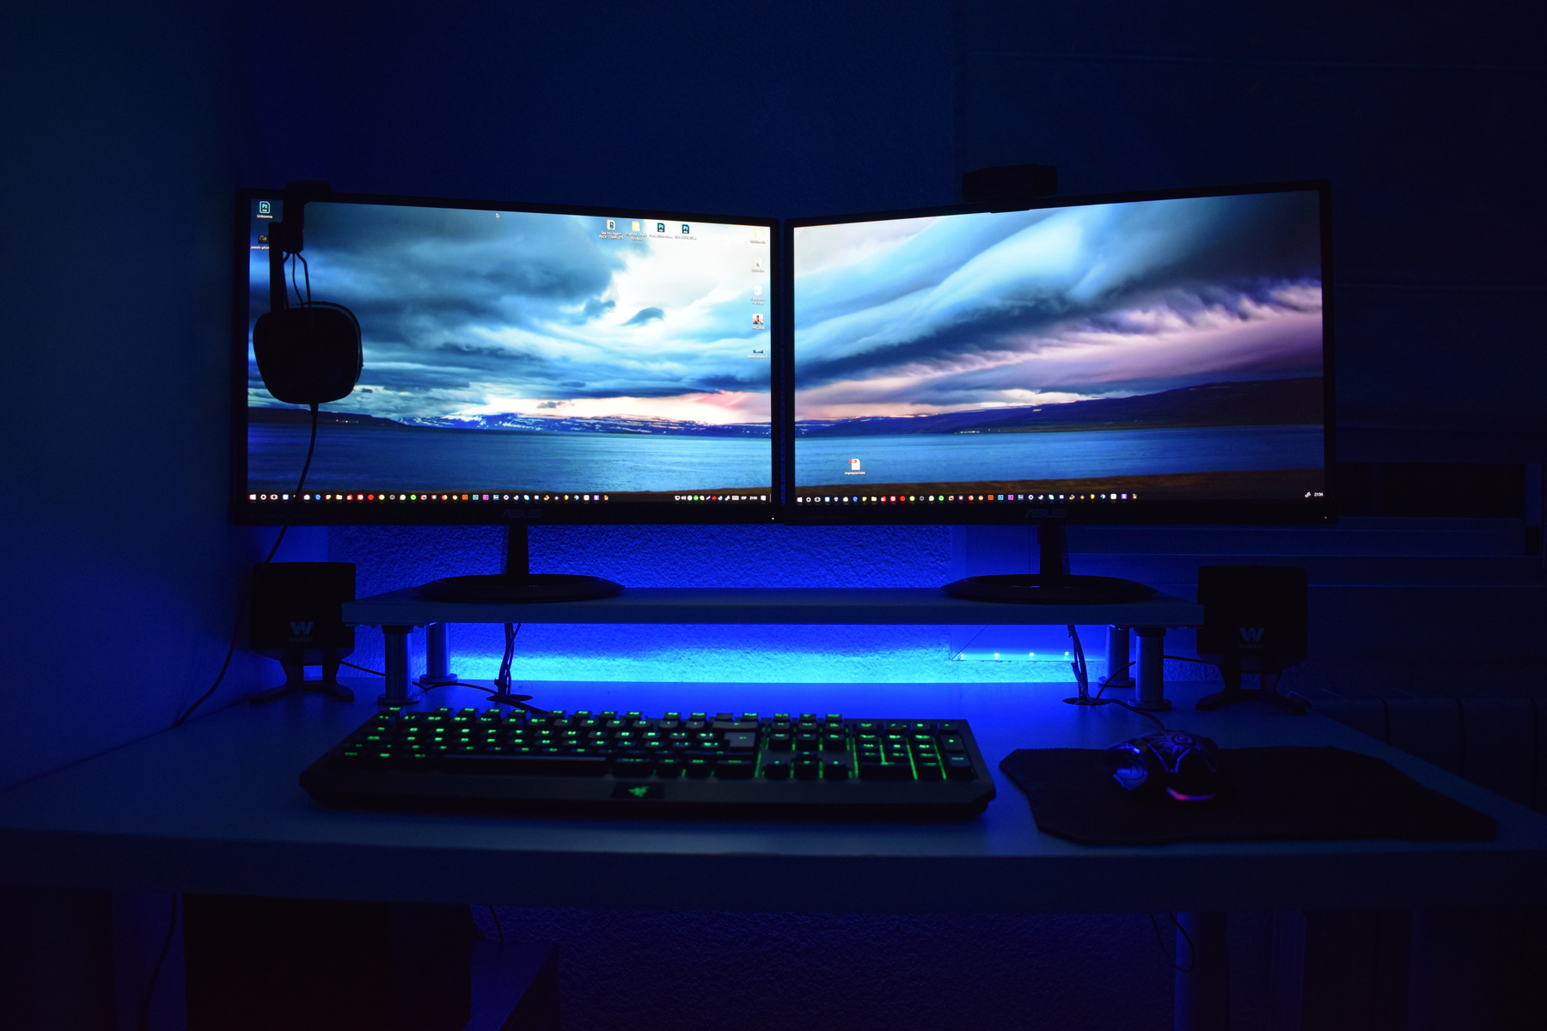
MINI PROJECT
Conversion of dark exposure images to more brighter images and creation of GUI
COMPUTER VISION
Presented by
Viraj Edlabadkar
Pranav Kumar Gupta
Mahi Rahman

Slide 2

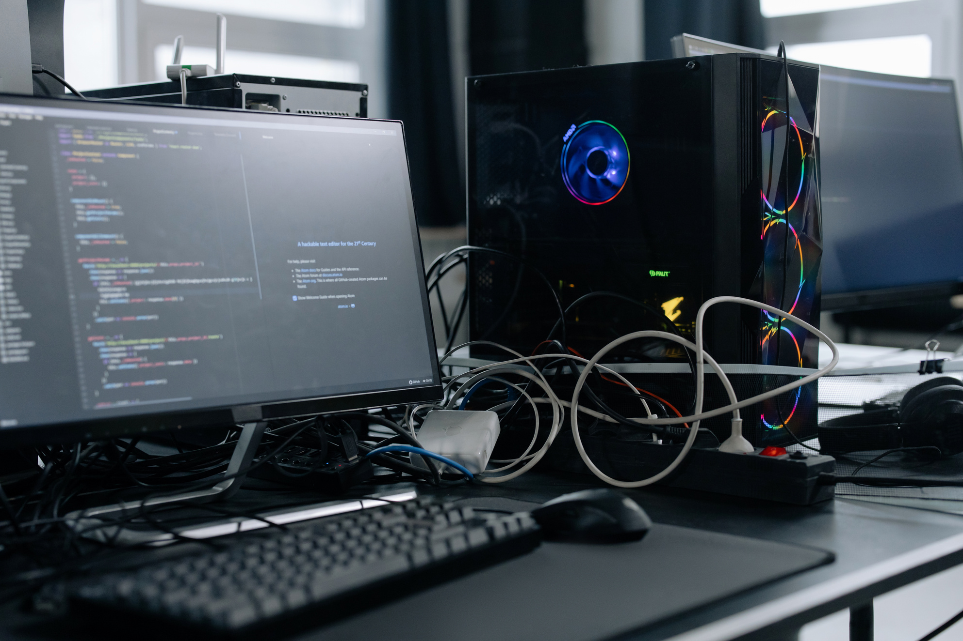
What exactly is our project?
This project is a user-friendly tool for enhancing underexposed images by applying advanced computer vision techniques.
Using methods like CLAHE (Contrast Limited Adaptive Histogram Equalization), Linear Contrast Stretching, Luminance Adjustment, and Gamma Correction, the tool improves image brightness and contrast effectively.
Built with OpenCV and Streamlit, it provides an intuitive interface where users can adjust settings in real-time, allowing easy experimentation with different enhancement methods to achieve optimal image quality.

Slide 3
realtime applications of the project
Medical Imaging
Astronomy and Remote Sensing
Enhances the visibility of details in X-rays, MRIs, and CT scans, especially in underexposed areas, aiding in more accurate diagnoses by improving contrast in critical regions..
Enhances contrast and brightness in images of space or satellite captures of Earth, where lighting can vary drastically. This helps scientists and researchers better analyze celestial objects or monitor geographical changes.
Security and Surveillance
Photography and Social Media
Improves the quality of low-light surveillance footage, making it easier to identify objects, people, or activities captured in challenging lighting conditions, such as nighttime or dim environments
Allows photographers and social media users to easily enhance underexposed photos, bringing out details in shadows and dark areas to improve image quality before sharing or publishing.

Slide 4
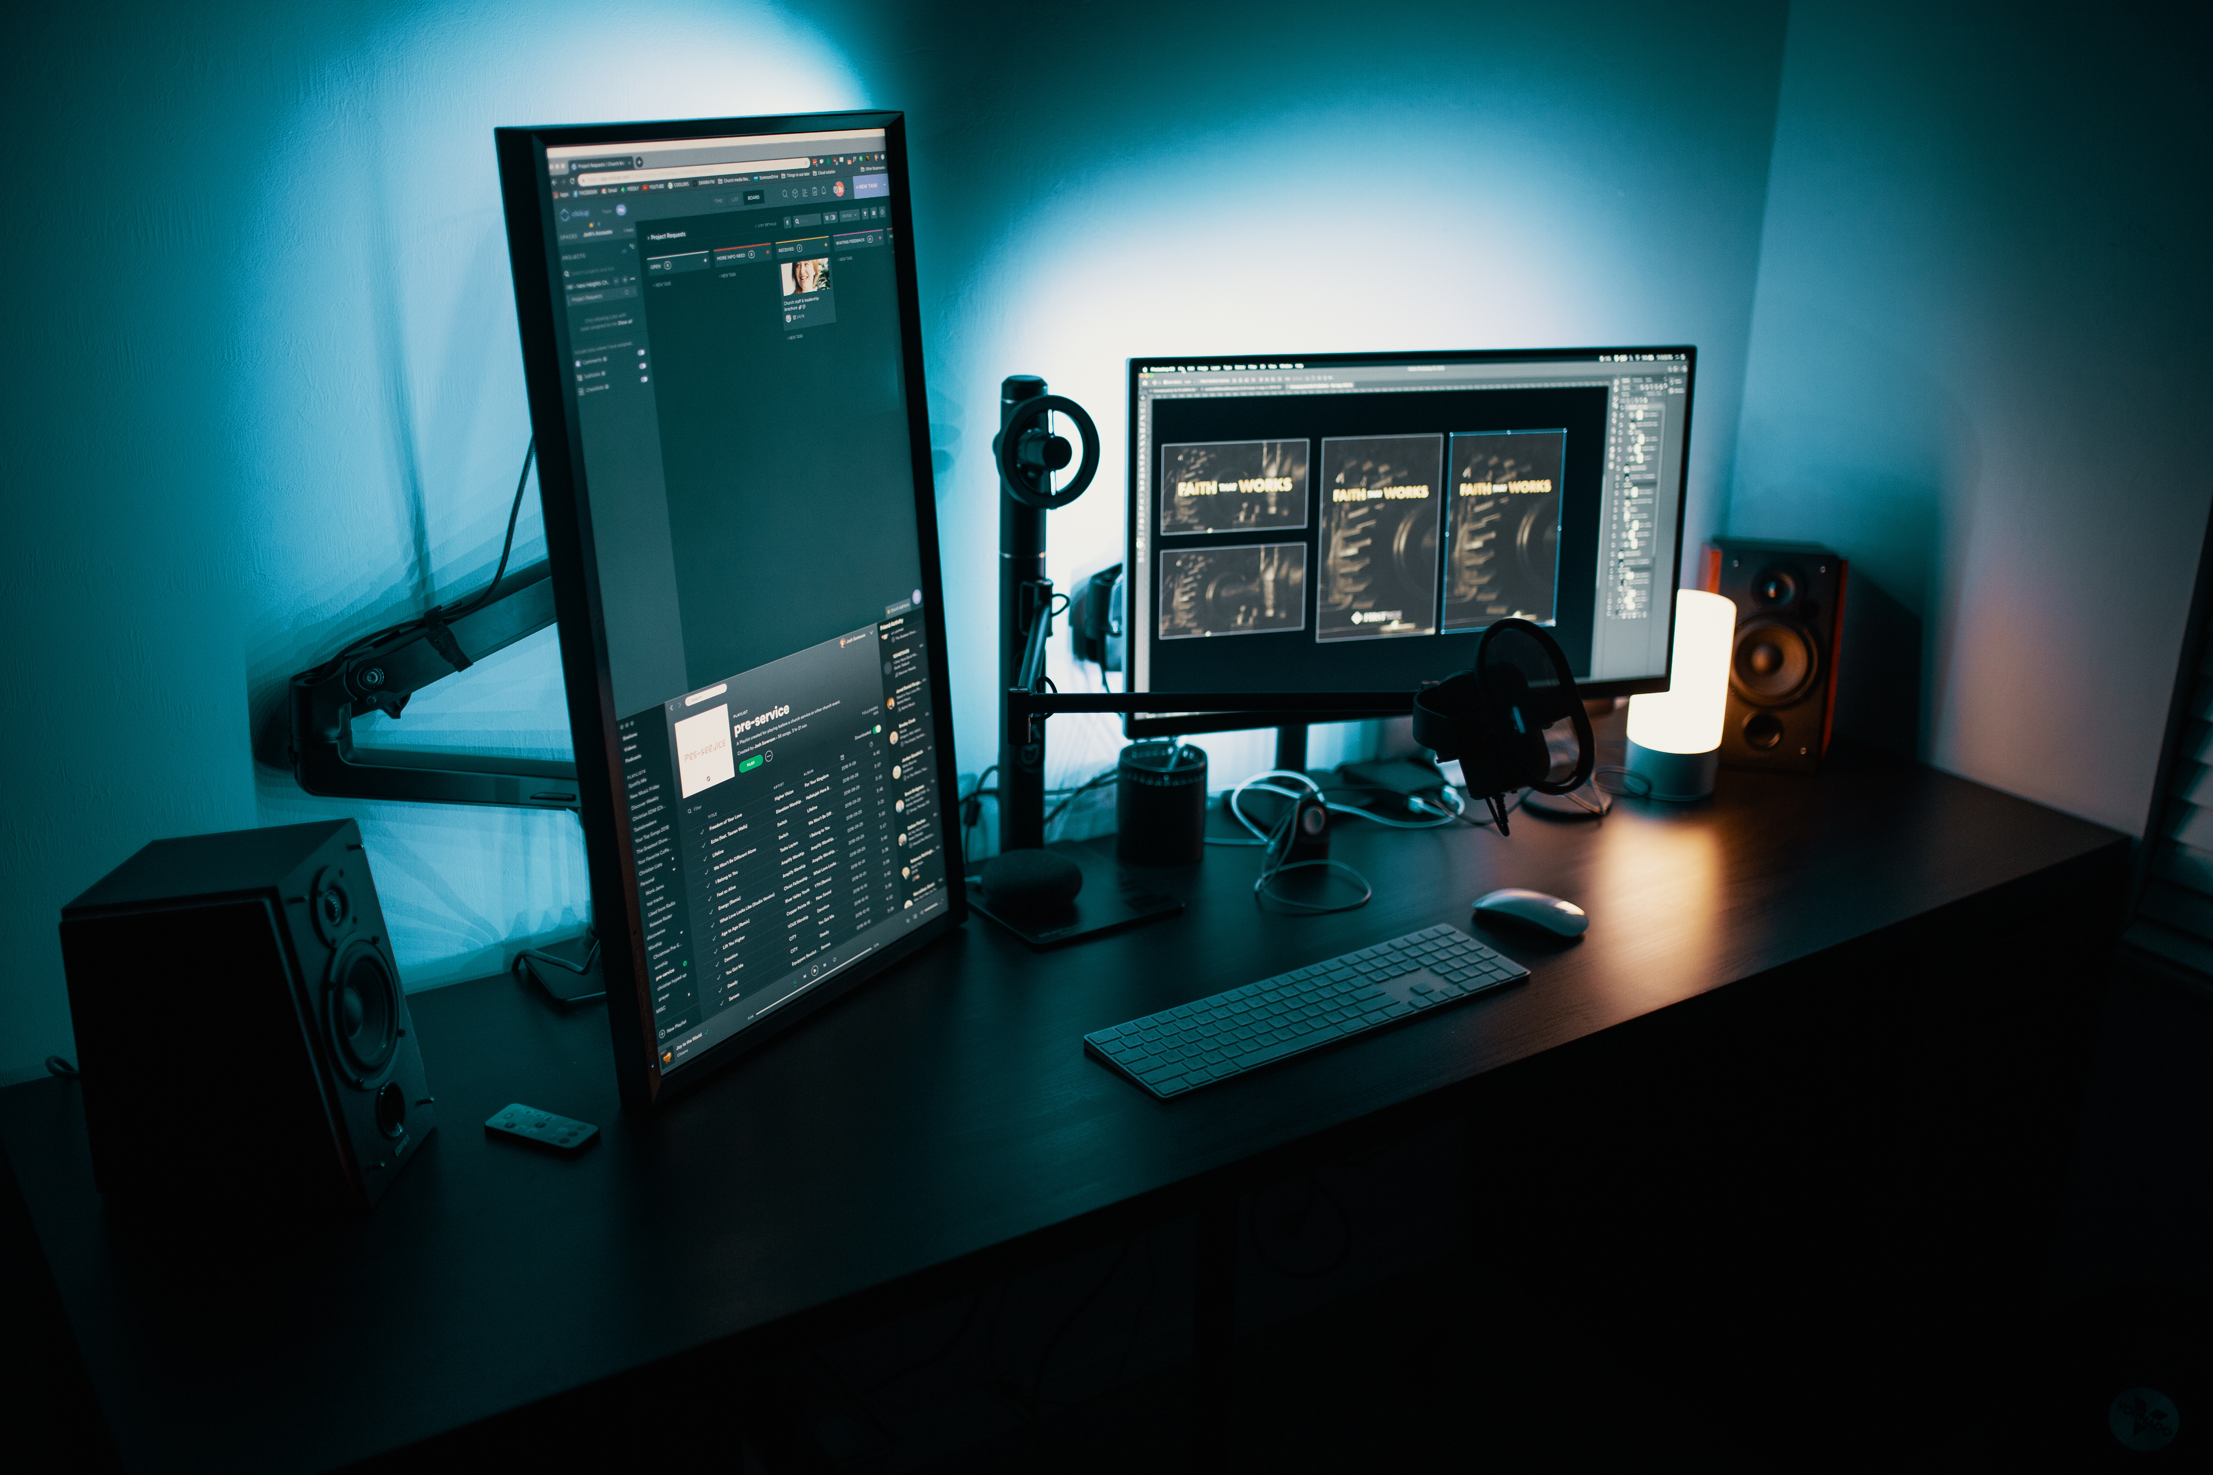
DIVING INTO THE CODE
“Let us now unlock the power of image enhancement by exploring how advanced algorithms can transform underexposed images into visually clear, high-contrast results.”

Slide 5


1) CLAHE ( Contrast Limited Adaptive Histogram Equalization )
CLAHE (Contrast Limited Adaptive Histogram Equalization) is an image processing technique that improves local contrast by applying histogram equalization to small regions within the image, preventing over-amplification of noise and enhancing details, especially in textured or low-light areas.
CLAHE works by dividing an image into small tiles and performing histogram equalization on each tile individually.
This adaptive approach enhances local contrast without over-brightening the entire image.
To prevent noise amplification, CLAHE limits the contrast in each tile, then combines the enhanced tiles smoothly for a balanced, detailed result.

Slide 6
2) Linear Contrast Stretching
How It Works:
Adjusts the minimum and maximum pixel values to stretch them across the full intensity range.
Ensures a uniform brightness improvement without changing color balance or tone.
What is it?
A method that scales pixel values linearly across the entire intensity range (0–255), increasing overall contrast and brightness.

Slide 7
3) Luminance Adjustment
What is it?
A technique that adjusts the brightness of an image by aligning it with the luminance levels of a well-lit reference image, creating a natural lighting effect.
How It Works:
Converts both the input and reference images to luminance (brightness) values.
Scales the input image’s brightness to match the mean and variance of the reference image’s luminance.

Slide 8
4) Gamma correction
How It Works:
Applies a gamma function to each pixel’s intensity, where gamma values <1 brighten and >1 darken the image.
Allows precise brightness control, especially useful for enhancing shadowed regions without affecting highlights.
What is it?
A non-linear brightness adjustment that controls how dark or bright an image appears by modifying pixel values according to a gamma curve.

Slide 9
after math
Implementing these image enhancement methods we obtained these results.

Slide 10

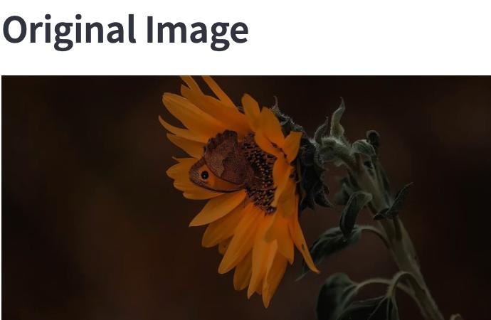

Slide 11
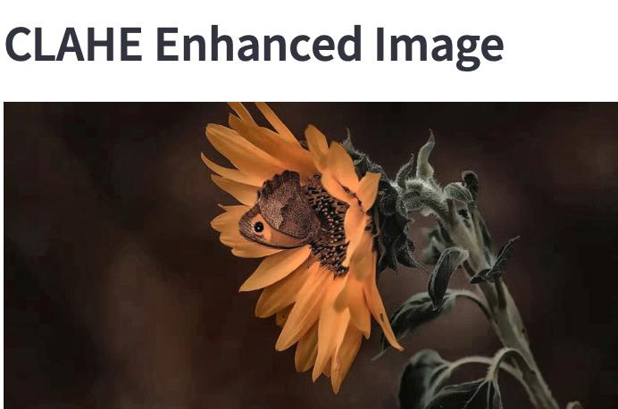
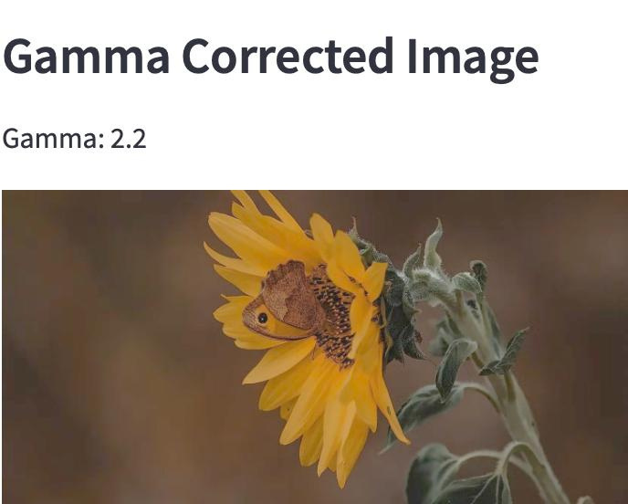
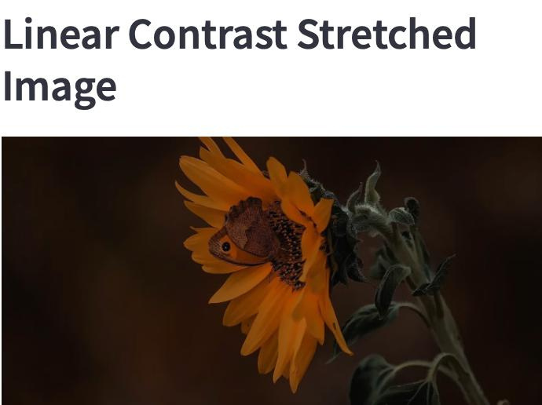
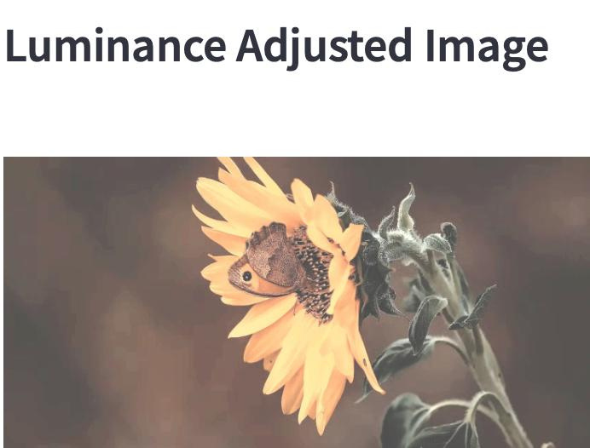

Slide 12
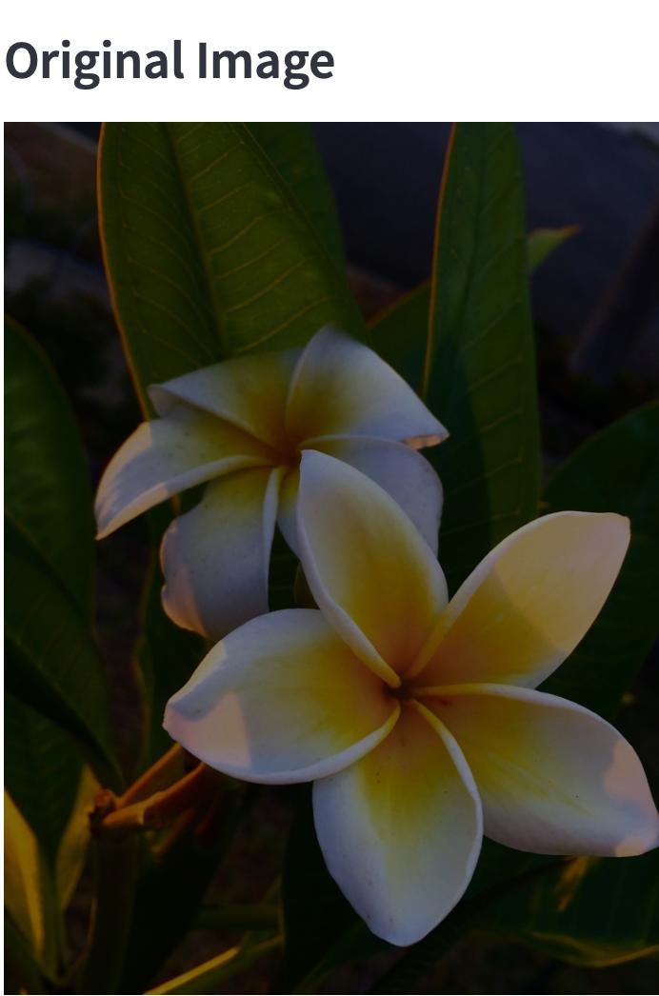

Slide 13
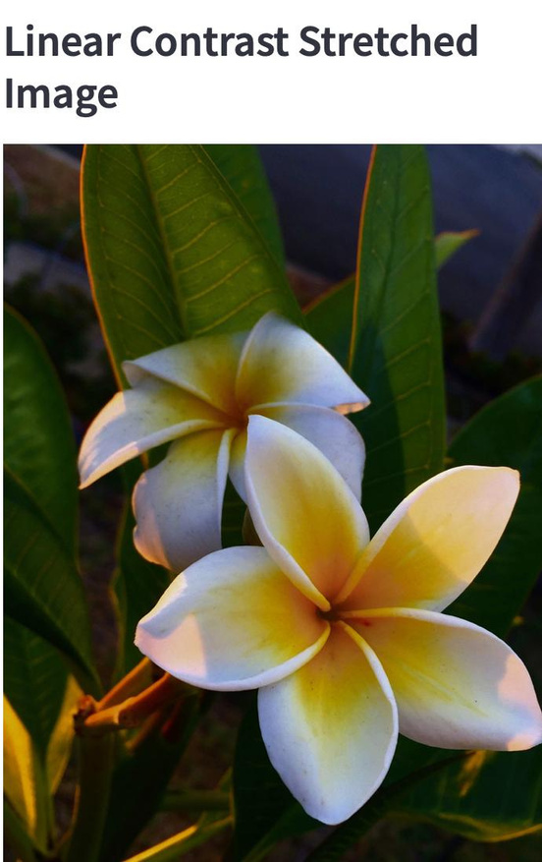
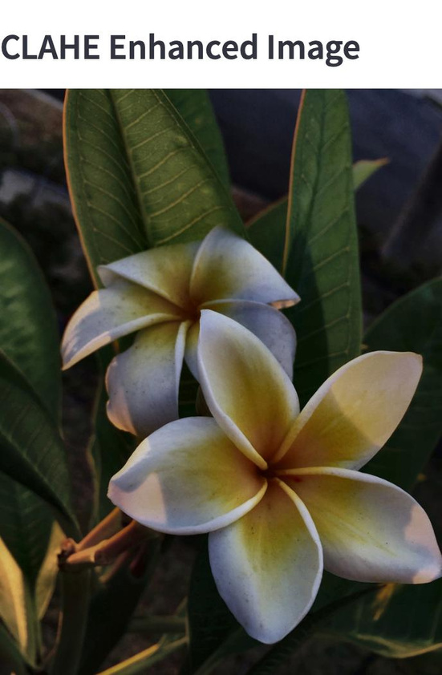
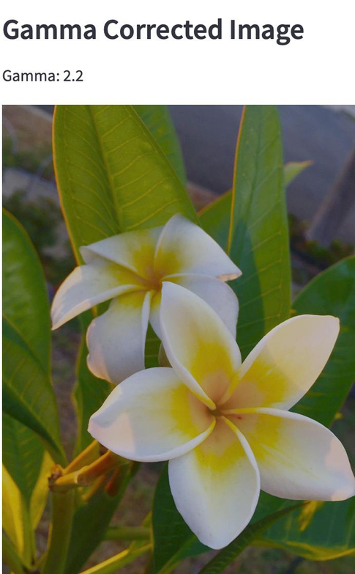
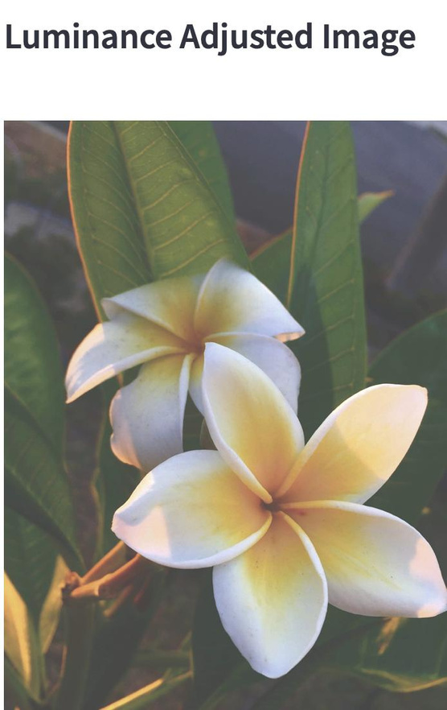

Slide 14
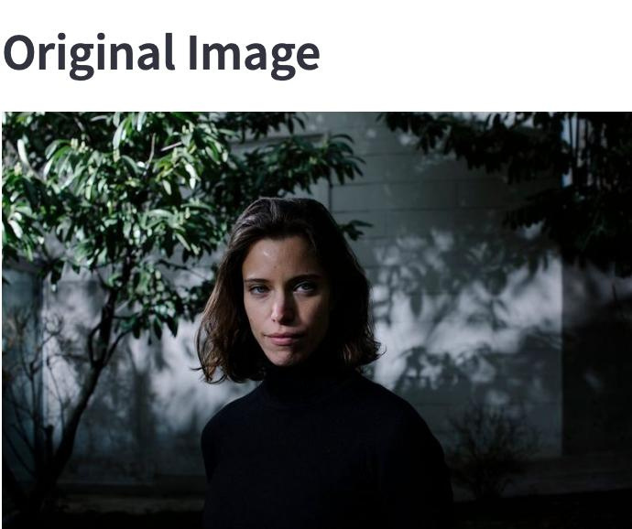

Slide 15
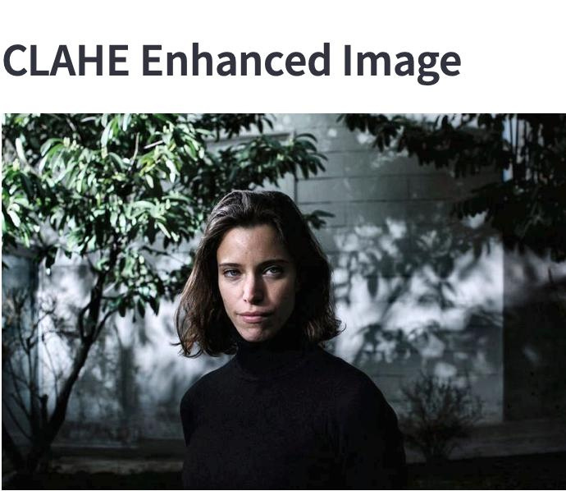
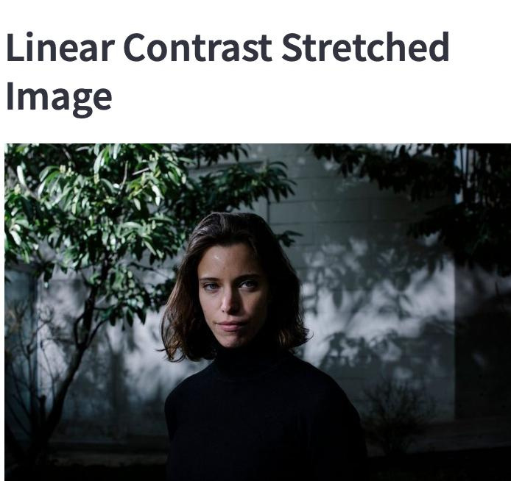
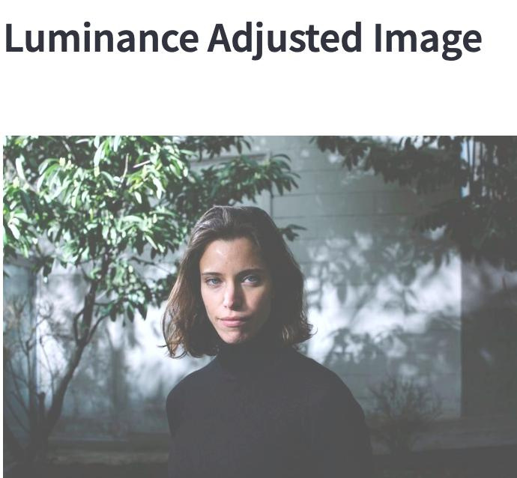
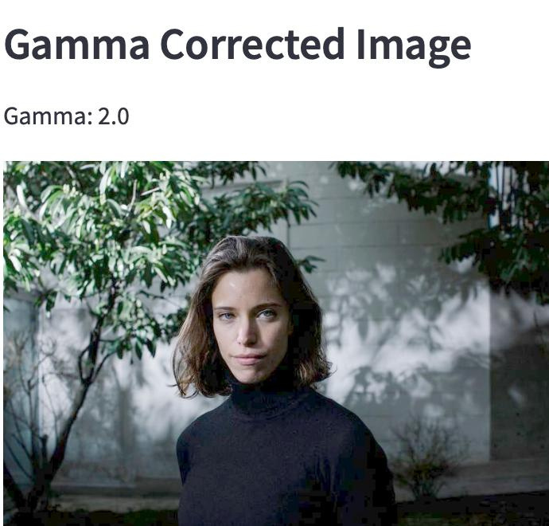

Slide 16

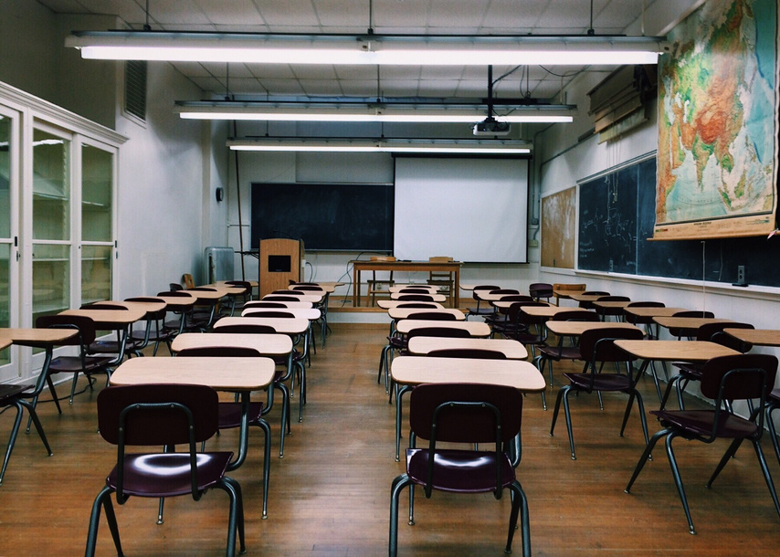


Noise reduction and Detail Prevention
future improvements
To further improve results and make sure that image enhancements don't magnify noise or distort small details, techniques like unsharp masking using gaussian blur and box filter.
Improved User Interface Features
Machine Learning for Technique Recommendation
Include a machine learning model to find the best fit method for a particular input image.
1) Processing log
2) Processing Time
3) Saved Output File

Slide 17
Conclusion
In conclusion, this project demonstrates a comparative analysis of four contrast enhancement techniques—CLAHE, linear contrast stretching, luminance adjustment, and gamma correction—using an interactive Streamlit interface. Each method offers distinct advantages, from preserving details in low-light areas to achieving natural brightness adjustments. By enabling side-by-side comparisons, this application provides valuable insights into selecting the most effective enhancement approach for varied image conditions, potentially benefiting fields that rely on high-quality image analysis, such as medical imaging, surveillance, and photography.

Slide 18


Thank you

